Slide 1
Cryptic Chambers: Exploring Medieval Games with Algorithms

Slide 2
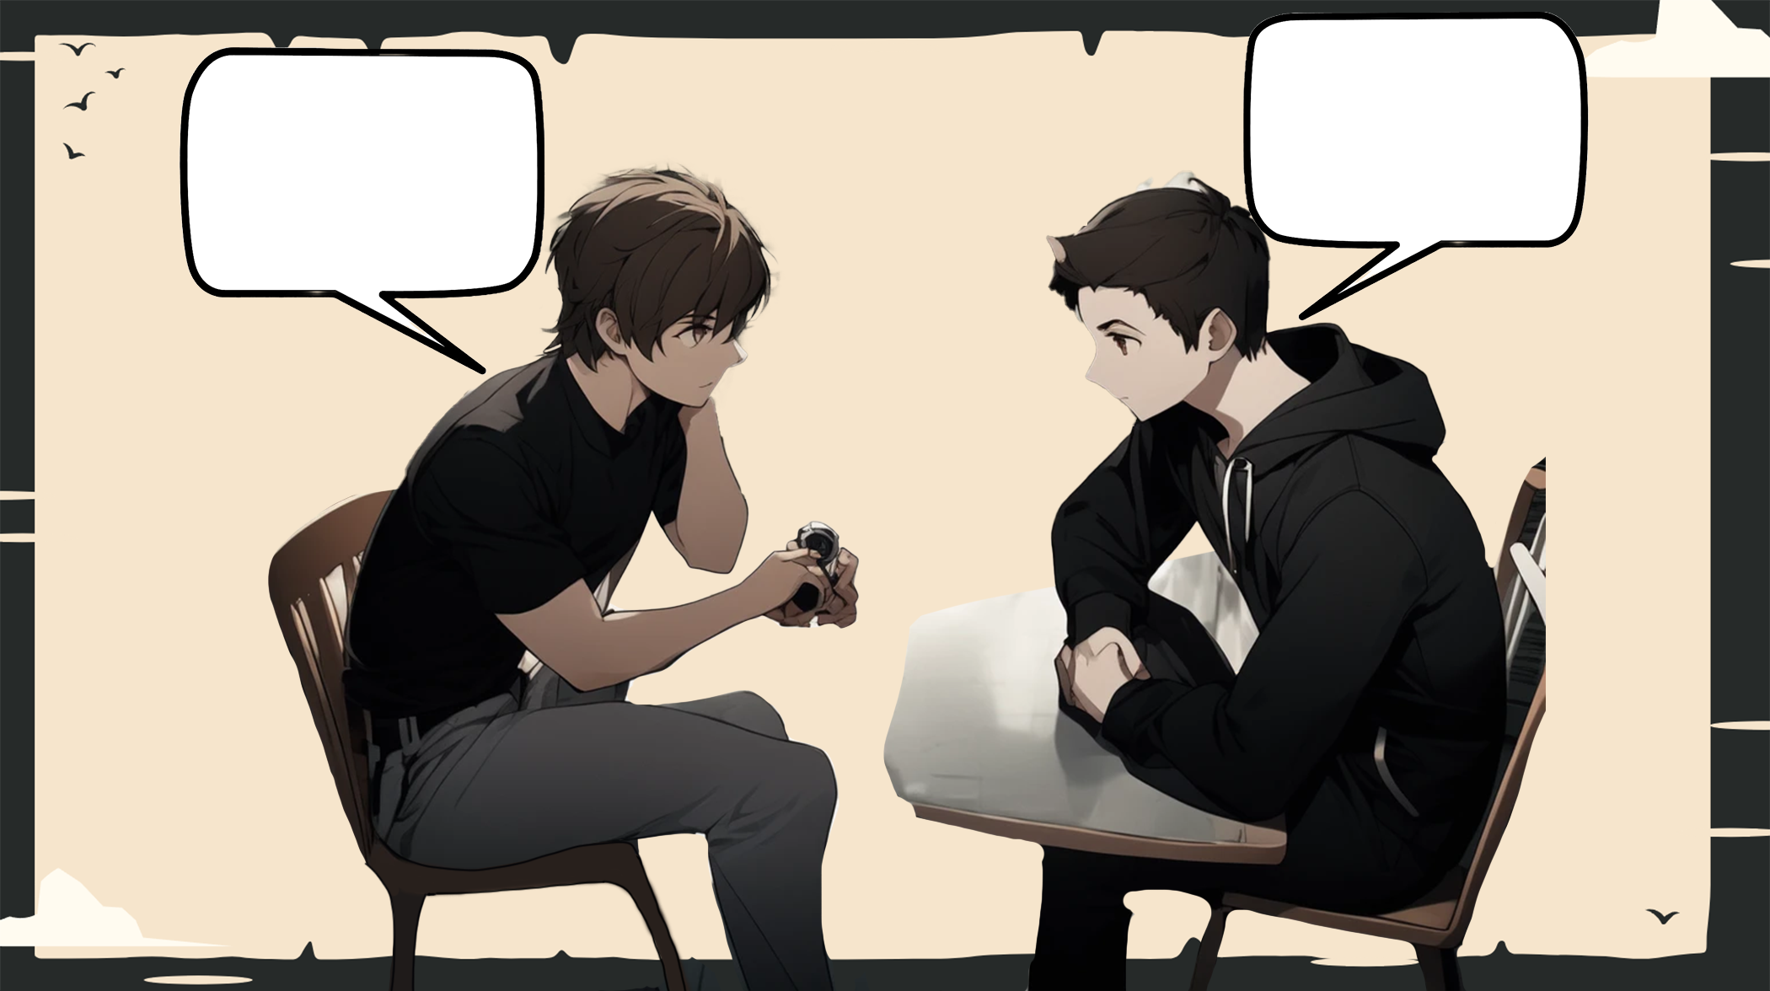
In the small town of Willowbrook, a group of friends gathered in Andrej's basement. They were avid fans of escape room games and had decided to create their own. They called their game 'Cryptic Chambers'.
The group consisted of Nikola, the creative mastermind; Andrej, the tech wizard; Peter, the puzzle enthusiast.
Act I:
The friends spent days designing the game, creating intricate puzzles and challenges. They transformed Andrej's basement into a mysterious dungeon-like setting, complete with dim lighting and eerie sound effects. The centerpiece of the game was a large maze that players had to navigate to find the hidden route to continue to the next level.
Act II:
On the day of the game launch, a group of excited players arrived at Andrej's house. The friends explained the rules and set them on their way to the first challenge. As the players made their way through the maze, they encountered riddles, hidden clues, and mind-bending puzzles. The atmosphere was tense as the players raced against the clock to solve the cryptic word. Meanwhile, Petar, Andrej and Nikola watched from a control room, monitoring the players' progress.
Act III:
Cheers erupted as the players emerged from the maze, victorious. The friends congratulated them on their success, proud of their creation.
We created an unforgettable experience for them, and that's what matters.'
And so, Cryptic Chambers became a popular attraction in Willowbrook. The friends continued to design more games, each one more challenging and thrilling than the last. They found joy in bringing people together and creating unforgettable adventures.

Slide 3
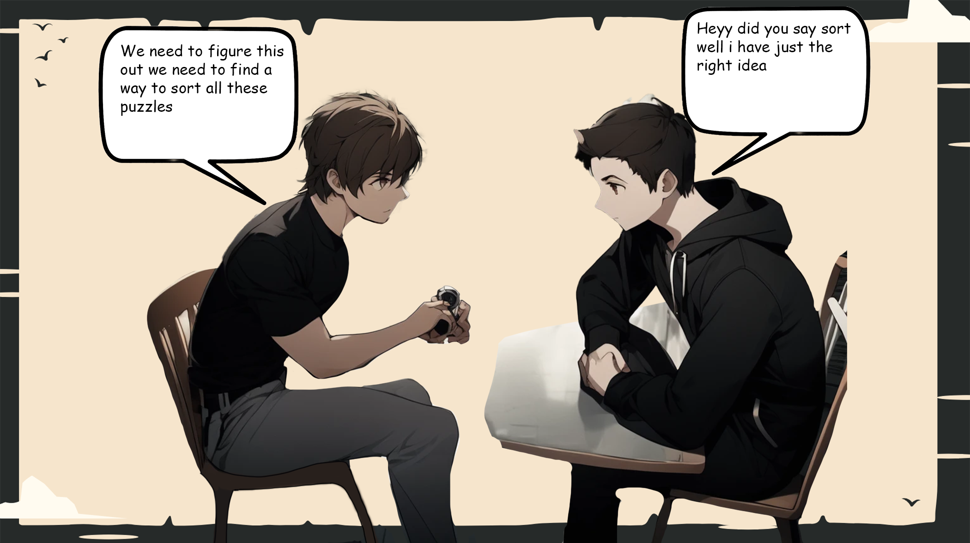

Slide 4

Merge Sort Algorithm
Description: Divides the list into two halves, recursively sorts each half, and then merges the sorted halves back together. Follows the divide-and-conquer paradigm.
Algorithm:
Divide: Split the unsorted list into two halves.
Conquer: Recursively sort each half.
Combine: Merge the sorted halves to produce a single sorted list.
Time Complexity: O(n log n) in the worst case.
Advantages:
Stable and reliable performance.
Well-suited for large datasets.
Disadvantages:
Requires additional space for merging.

Slide 5

Implementing Merge Sort in the scoreboard of our games reflects a strategic and efficient approach to organizing and presenting data. Merge Sort, known for its stability and consistent O(n log n) time complexity, is particularly well-suited for scenarios where maintaining a sorted order is crucial, such as in scoreboards. In this implementation, the Merge Sort algorithm likely plays a pivotal role in sorting and arranging the scores of players or teams. By dividing the scoreboard into smaller, sortable segments and then merging them in a systematic manner, we ensure that the final result is a well-organized and ordered display of game performance. The decision to employ Merge Sort suggests a commitment to optimizing the performance of the scoreboard, especially as the dataset grows larger. This sorting algorithm excels in scenarios where maintaining a clear and sorted representation of scores is not only beneficial for users but also ensures efficient and reliable access to relevant

Slide 6

Linear Search:
Binary Search:
Description: Sequentially checks each element in a list until a match is found or the end of the list is reached.
Algorithm: Iterate through the list, comparing each element with the target.
Time Complexity: O(n) in the worst case.
Description: Efficiently finds a target in a sorted list by repeatedly dividing the search interval in half.
Algorithm: Compare the target with the middle element, narrowing the search to the upper or lower half.
Time Complexity: O(log n) in the worst case.

Slide 7

Searching algorithms play a crucial role in locating specific elements within a dataset. In the case of our word search game, we employ both binary and linear search algorithms to streamline the search process.
Binary search, tailored for sorted datasets, excels by repeatedly dividing the search space in half. This method optimally homes in on the target by efficiently checking if a guessed word aligns with the correct answers sought. This approach significantly reduces the search space with each iteration, achieving a commendable time complexity of O(log n) in the worst case.
On the flip side, linear search provides a simpler strategy for unsorted datasets, as is often the case in our word search game. This algorithm sequentially scans through the entire list, checking if the current guess corresponds to the target word. While less efficient, especially for larger datasets, linear search serves its purpose by exhaustively examining each element until a match is found or the end of the list is reached. Its time complexity is O(n) in the worst case.
In the context of our word search game, binary search optimizes the process by efficiently confirming whether a word is one of the correct answers, leveraging the sorted nature of the data. Meanwhile, linear search takes a more straightforward approach, ensuring that the algorithm checks whether a word has already been confirmed or not. Both methods contribute to the essence of the search, affirming whether a guessed word aligns with the desired elements in our word search game.

Slide 8
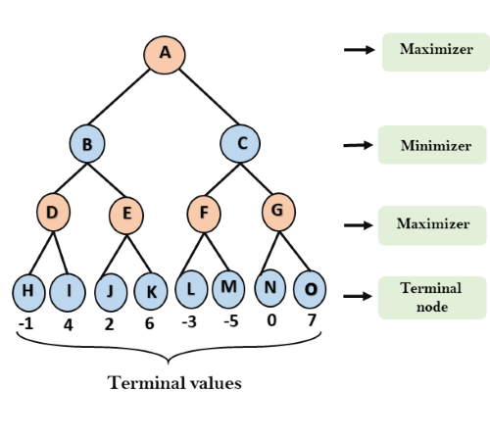
Recursion minimax:
Objective: Minimize the possible loss while maximizing potential gain in two-player games.
Algorithm Steps: Recursively explores the game tree, alternating between Max and Min players.
Player Roles:
Max player maximizes the score/utility.
Min player minimizes the score/utility.
Utility Function: Assigns numerical values to game states, indicating desirability for the Max player.
Decision: Chooses moves leading to minimum loss (Min player) or maximum gain (Max player) at each level.
Example: In tic-tac-toe, evaluates all moves, assuming optimal play from both players.
Considerations:
Computationally expensive for deep game trees.
Alpha-beta pruning optimizes performance by discarding irrelevant branches.
Widely used in AI for board games and decision-making scenarios.

Slide 9

In the intricate realm of Tic-Tac-Toe, the implementation of a recursion algorithm adds a layer of strategic depth and elegance to the game's decision-making process. Recursion, a powerful concept in computer science, allows us to break down the complexity of Tic-Tac-Toe into more manageable sub-problems, contributing to a sophisticated and efficient gameplay strategy.
In order to save time the first move is randomized. Consider the recursive nature of determining the optimal move in Tic-Tac-Toe. At each turn, the algorithm evaluates the current board state, exploring potential moves and their outcomes by simulating future game scenarios. This recursive exploration continues until a terminal state, such as a win, loss, or draw, is reached. The algorithm then backtracks, assigning a score to each move based on its desirability, considering wins as positive outcomes and losses as negative outcomes.
The recursive nature of the algorithm allows it to navigate through the expansive decision tree of possible moves, dynamically adapting its strategy based on the evolving state of the game. This approach is fundamental to creating a competitive AI opponent in Tic-Tac-Toe, providing players with a challenging and engaging gaming experience.
In summary, the integration of a recursion algorithm in Tic-Tac-Toe elevates the game's strategic complexity, enabling an intelligent decision-making process that adapts to various game states. This recursive approach contributes to the creation of a sophisticated AI opponent, enhancing the overall gameplay dynamics and providing players with a more immersive and challenging experience.

Slide 10
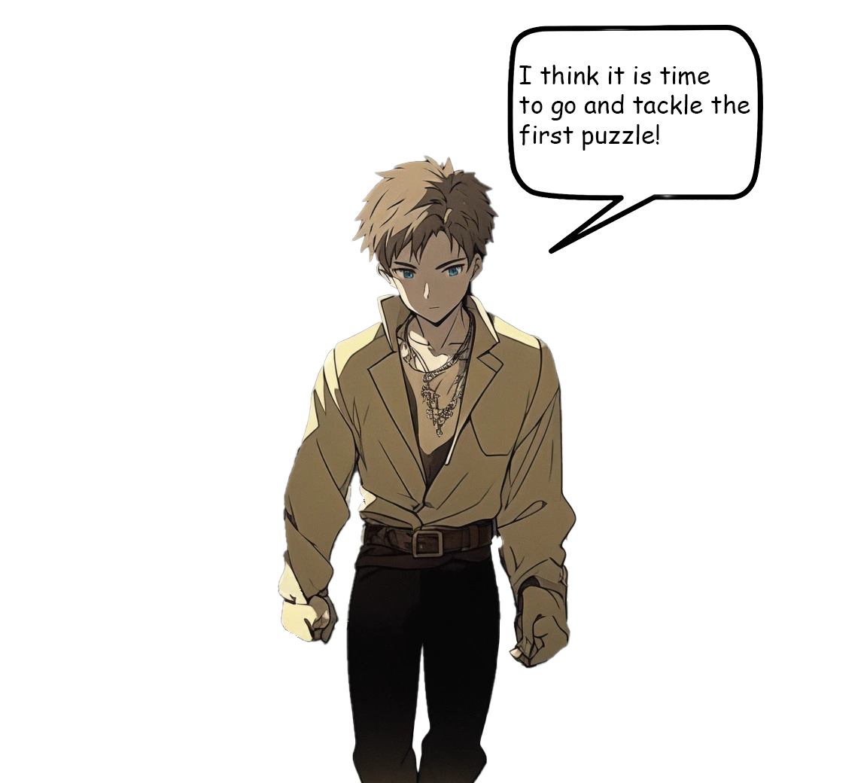

Slide 11



5837
5806
5877

